Slide 1
Daily Scrum
08/11
Hye Ji Park Java A-4 SK Didimdol 4th ehddn159@naver.com

Slide 2
Task List
Assigned Task | Progress
변경된 DB에 알맞게 roomsList, roomsAdd, roomsList VO 수정 | 100%
변경된 DB에 알맞게 roomsList, roomsAdd, roomsList Controller, Mapper 작성 | 100%
checkBox true, false값 넘어가는 것 수정 | 100%

Slide 3
Yesterday’s Task
Today’s Task
Technical Issue

Slide 4
1. Yesterday’s Task
What I did?

Slide 5
1. Yesterday’s Task
How I did?
Html과 jQuery, css를 사용하여 화면을 구성하고 간단한 기능을 추가함

Slide 6

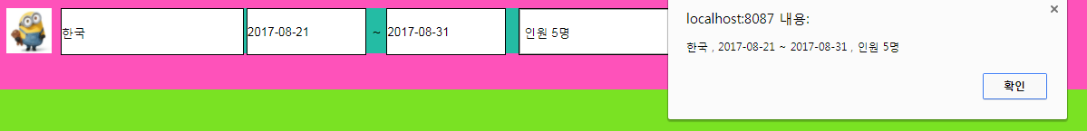
1. Yesterday’s Task
Result

Slide 7
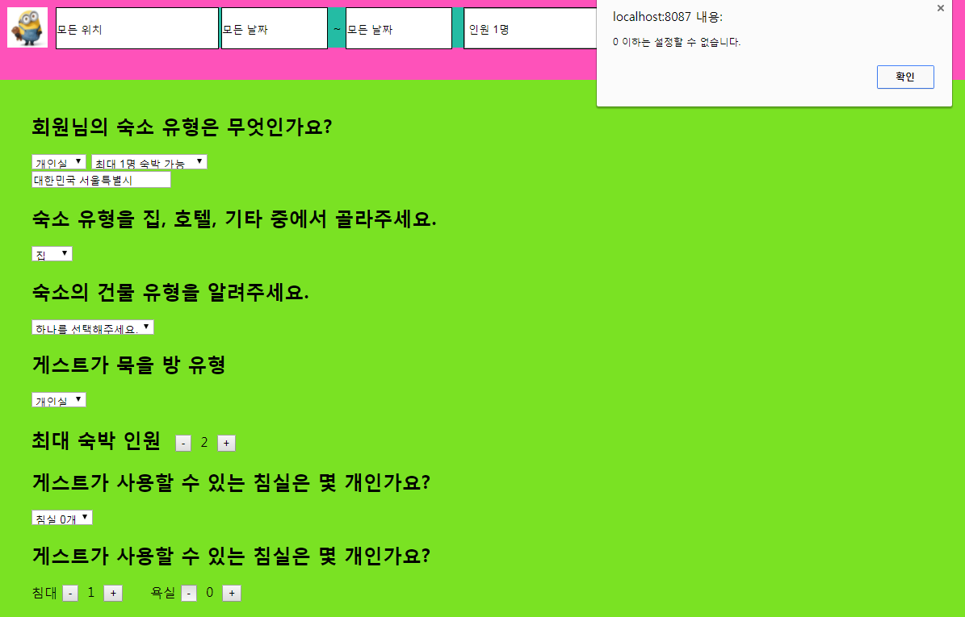
1. Yesterday’s Task
Result

Slide 8
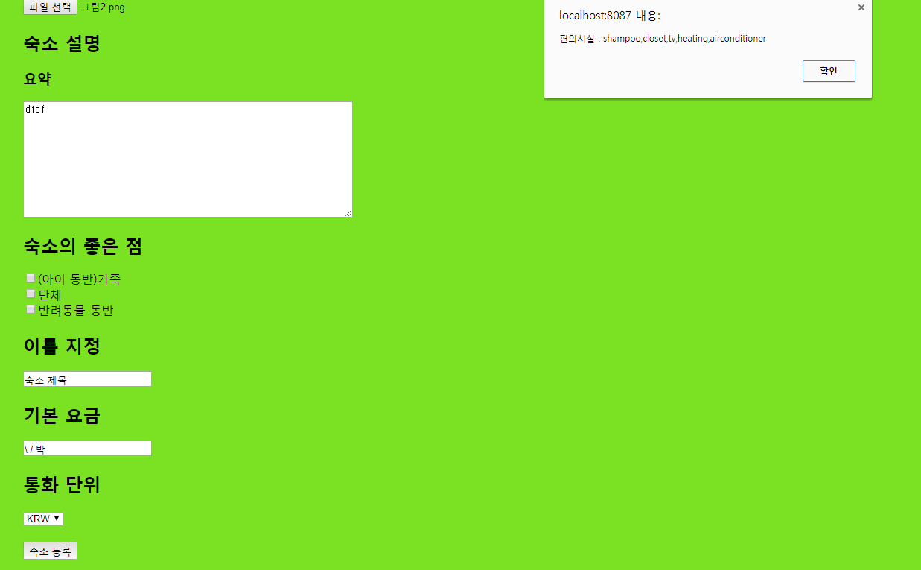
1. Yesterday’s Task
Result

Slide 9
Yesterday’s Task
Today’s Task
Technical Issue

Slide 10
2. Today’s Task
ToDo
DAO 생성
VO 생성
Controller 생성
Accommodation 데이터베이스 수정 및 vo, controller수정

Slide 11
Yesterday’s Task
Today’s Task
Technical Issue

Slide 12
3. Technical Issue
Issue
Html을 appendTo로 붙였을 때 ID와 CLASS가 효과가 없는 것 수정

Slide 13
END

